Slide 1
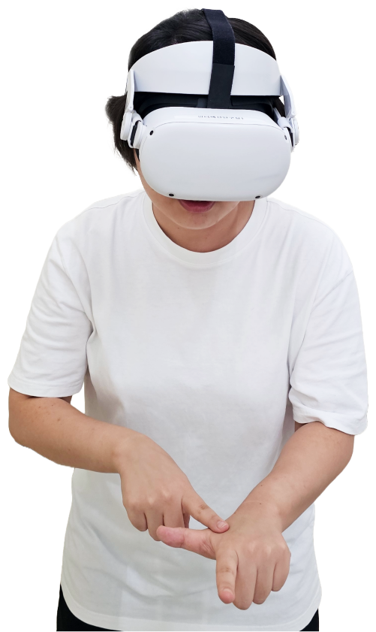
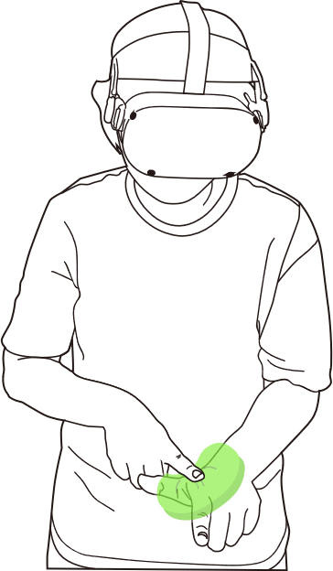

SkinHaptics Exploring Skin Softness Perception And Virtual Body Embodiment Techniques to Enhance Self-Haptic Interactions
Real World
Virtual World
Haptic Prop
Virtual Object
Touching
the Own Body
Touching
the Virtual Object

Slide 2
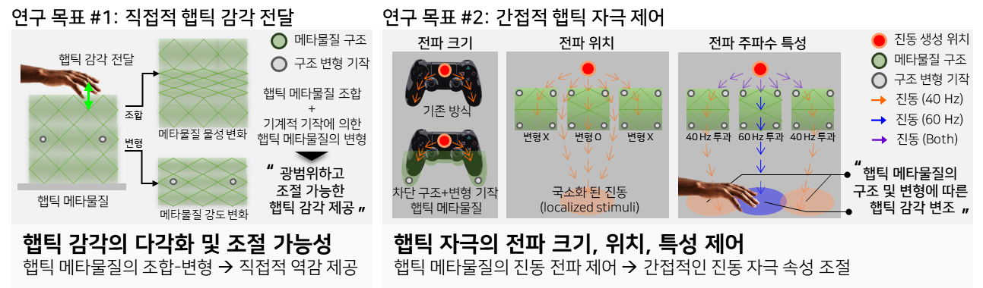

Haptic Metamaterial Using Elastic Metamaterials to Deliver Haptic Sensation

